Slide 1
ITLG311 - Business Communication
Faculty of ICT, Mahidol University
Semester 1, 2026/2027
Week 6: Forming a Consultancy and Conducting a Formal Business Meeting

Slide 2
Previously:
Getting Started: What Is Business Writing?
Digital Communications
Now you should know the main Business Communication Fundamentals
Now it is time to apply them as Business Communication Consultants

Slide 3
This Week:
Objectives:
Understand the concept of Business Consultation
Identify essential practices for effective Group Meetings & Meeting Management
Get started: Consultancy Work-group Setup
1. Theory of Consultation
2. Understanding how Business Meetings function
3. Consultancy Role Play Instructions
4. Assigning Groups
5. Getting Started

Slide 4
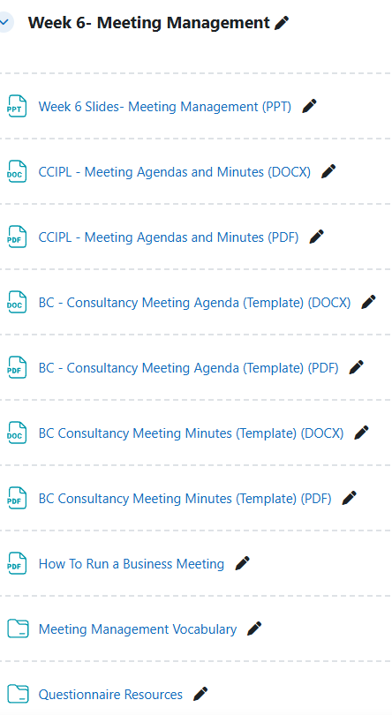
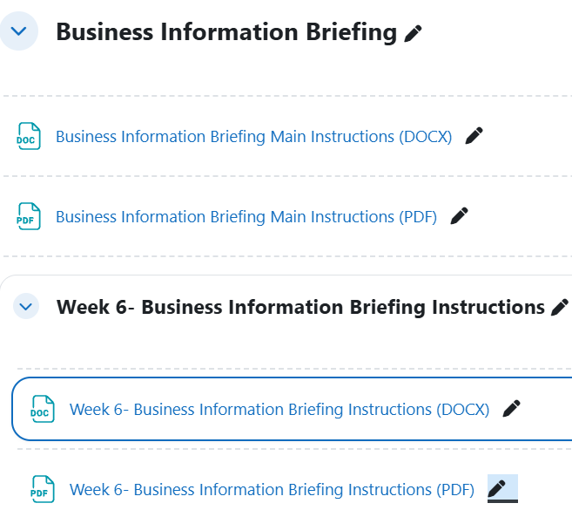
Resources

Slide 5
Additional Vocabulary for Today
Take a moment, try to define the following words:
Consult (v)
Consultant (n)
Consultancy (n)
Consultation (n)
Advice (n)
Advise (v)
Teamwork (n)
Collaborate (v)
Collaboration (n)
Collaborative (adj)
Collaboratively (adv)

Slide 6
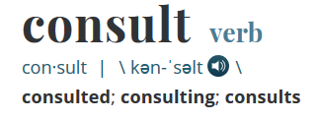
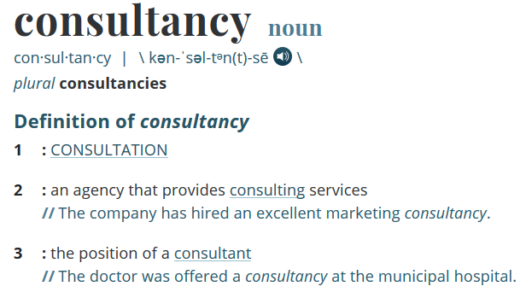
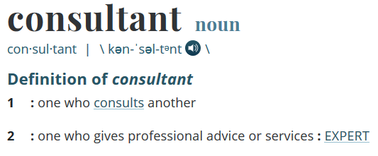
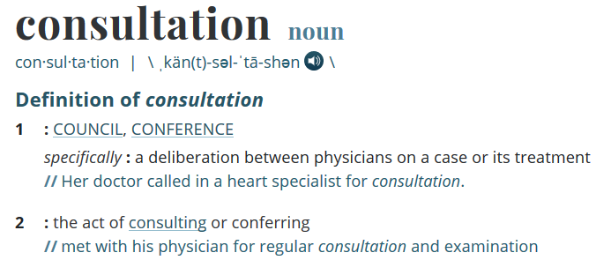
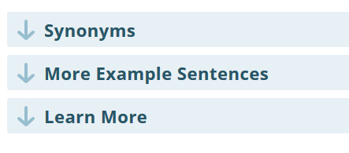
Vocab:

Slide 7
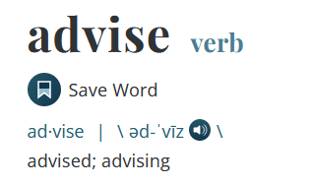
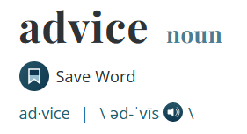
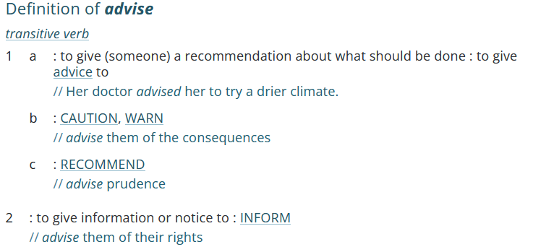
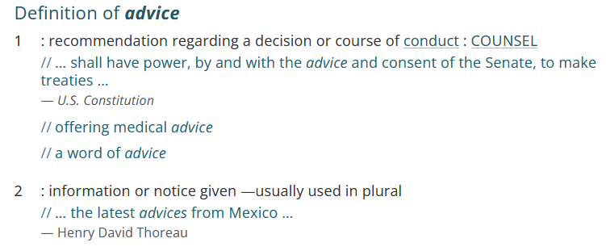
Vocab:

Slide 8
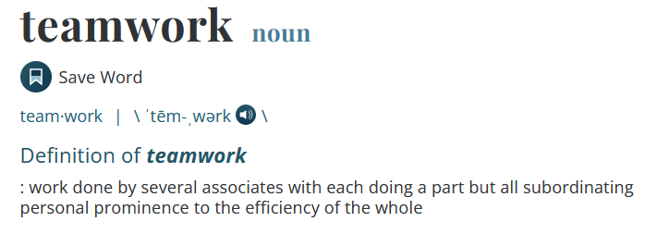
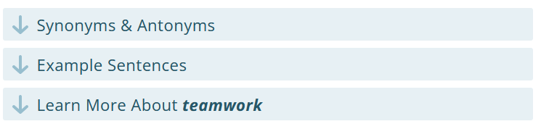
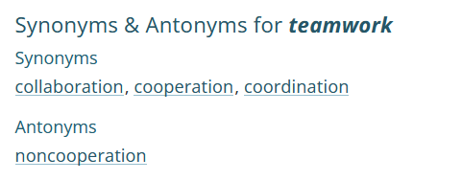


Vocab:

Slide 9
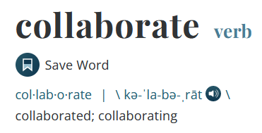
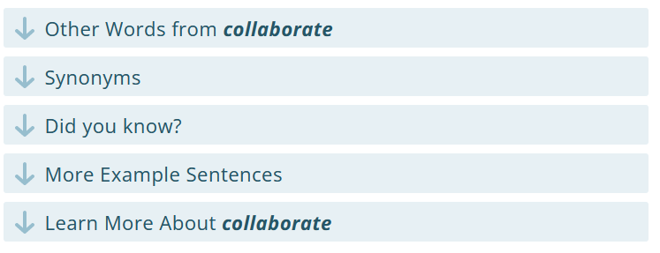
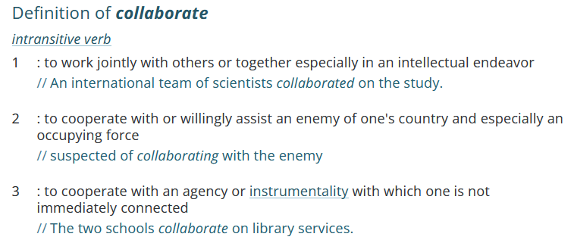
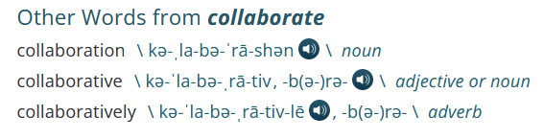
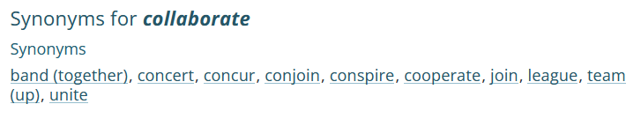
Vocab:

Slide 10
1. Who or What is a Consultant?
A consultant is:
A person who gives advice on a business area or problem
Normally an expert or someone with a lot of specialized knowledge about a topic
Example:
An ICT consultant is a person with a high degree of specialized technical knowledge who is able to advise other organizations about technical solutions for ICT related problems.
In other words, YOU are a consultant!

Slide 11
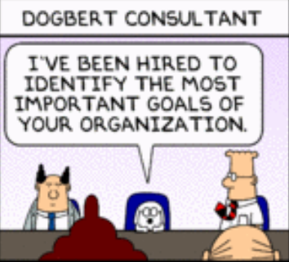
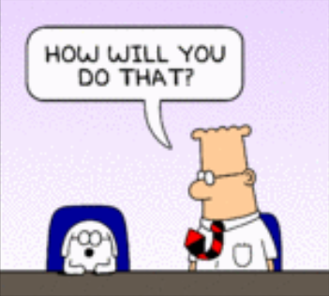
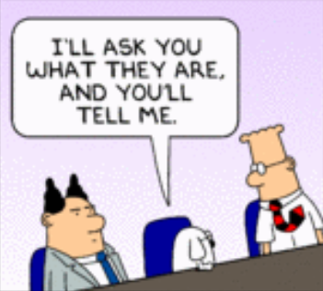
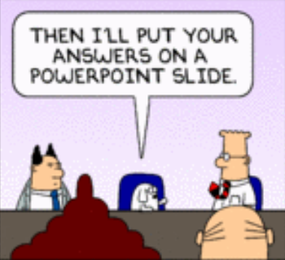
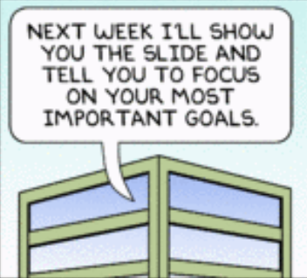
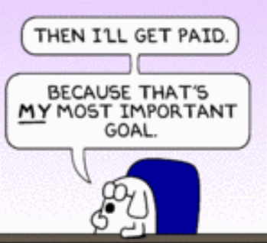
So, What Do Consultants DO?

Slide 12
Discuss:
What are meetings?
Can you give examples of some types of meetings?
What are some benefits/advantages of holding meetings?
What are some problems/disadvantages of holding meetings?
How can you make meetings successful?
What group dynamics play a part in meetings?

Slide 13
Meetings Definition
A business meeting is a real-time meeting between two or more individuals for the purpose of advancing corporate objectives.
Business meetings are an example of a formal meeting, and as a result they usually follow a clear structure dictated by their objectives.

Slide 14
Types of Meetings
1. STAND UP meetings
Only when necessary
Short
Involving
Some organizations do this for 15 minutes each day to update everyone on everyone’s progress
Stand up → Synch up → Wrap it up
Encourages team building and collaboration
Good for Problem Solving

Slide 15
Types of Meetings
2. SIT DOWN meetings
Very formal, Specific Focus
Follows a specific agenda – can range in time
Encourages participation
Goals → Agenda → Schedule/Invite → Act → Track & Report
Encourages effective time management
Good for dealing with Specific Issues

Slide 16
Why do we have meetings?
Notes:
Sharing Information
Making Decisions
Creating Solutions
Building Relationships
Sharing Inspiration
Negotiating
Educating Others
Brainstorming

Slide 17
Problems with meetings
No Agenda
Late start
Meeting goes off topic
Too long
Wrong people there
Someone dominates meeting
No follow up

Slide 18
Decisions: → Successful Meetings
Before the meeting: PLANNING
What should people do to make sure a meeting is well prepared?
During the meeting: EXECUTION
What can a meeting leader do to keep the meeting focused and make sure everyone can participate?
After the meeting: REFLECTION/ ACTION
What should happen after a meeting to make sure important information and decisions are not forgotten?
If a meeting ends with tasks that need to be completed, what should be recorded, and how can the team make sure they are completed?
Notes:
Before
Consider the Purpose/Audience
Consider the Location and Format of the meeting
Prepare the meeting agenda
Send an invitation and agenda to all participants
Provide essential information
Participants prepare themselves for the meeting
During
Leadership
Encourage willingness to participate
Respect the audience
Stick to goals outlined in agenda
Keep your meeting moving
Time Management
Set Actionable Items
After
Evaluate the meeting
Create a summary report/ minutes
Broadcast the summary report
Track assigned jobs/ tasks/ actions
Archive meeting documents

Slide 19
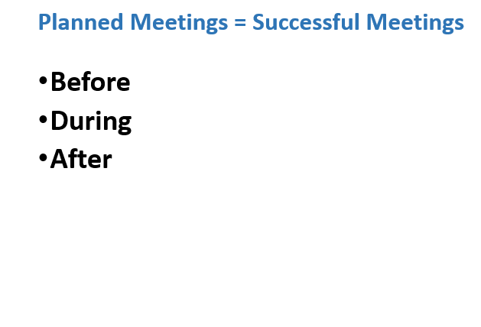
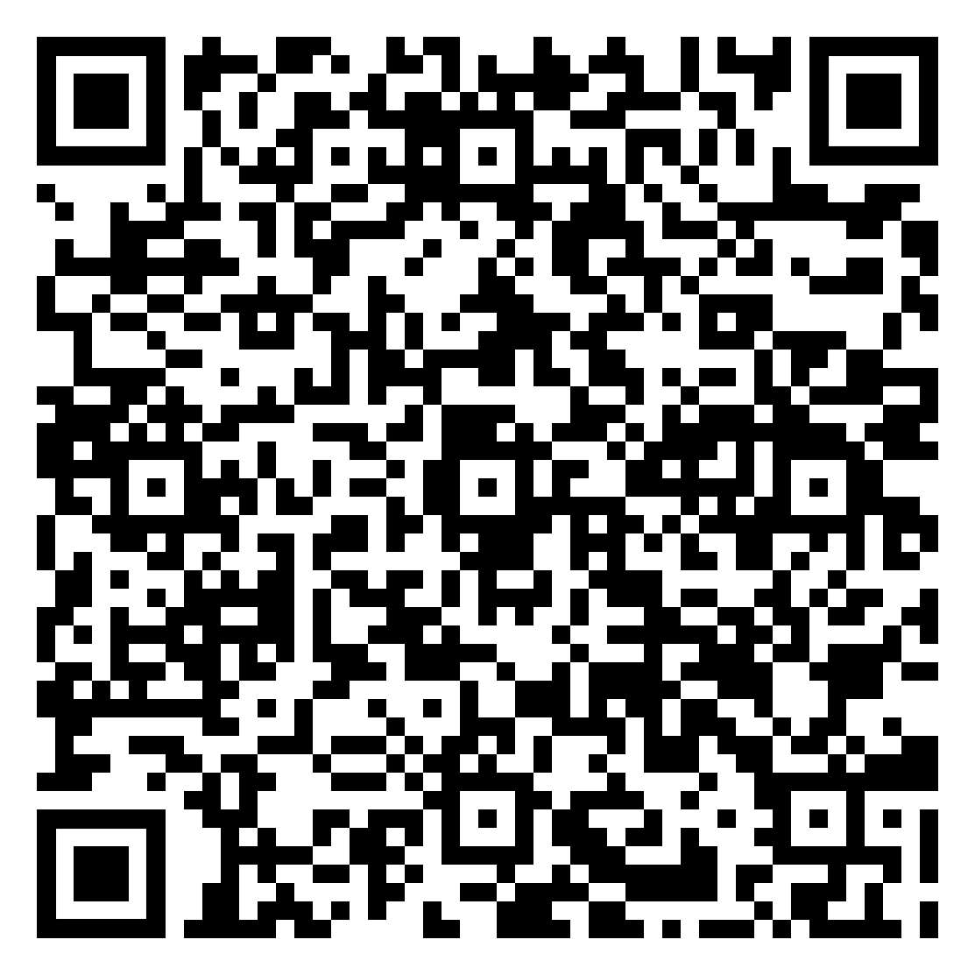
Meeting Management: Pro Tips
Before:
Plan your meeting:
Create an Agenda
During:
Follow your plan
Record outcomes
After:
Summarize discussions and decisions made
Distribute your Summary
Notes:
Before
Consider the Purpose/Audience
Consider the Location and Format of the meeting
Prepare the meeting agenda
Send an invitation and agenda to all participants
Provide essential information
Participants prepare themselves for the meeting
During
Leadership
Encourage willingness to participate
Respect the audience
Stick to goals outlined in agenda
Keep your meeting moving
Time Management
Set Actionable Items
After
Evaluate the meeting
Create a summary report/ minutes
Broadcast the summary report
Track assigned jobs/ tasks/ actions
Archive meeting documents

Slide 20
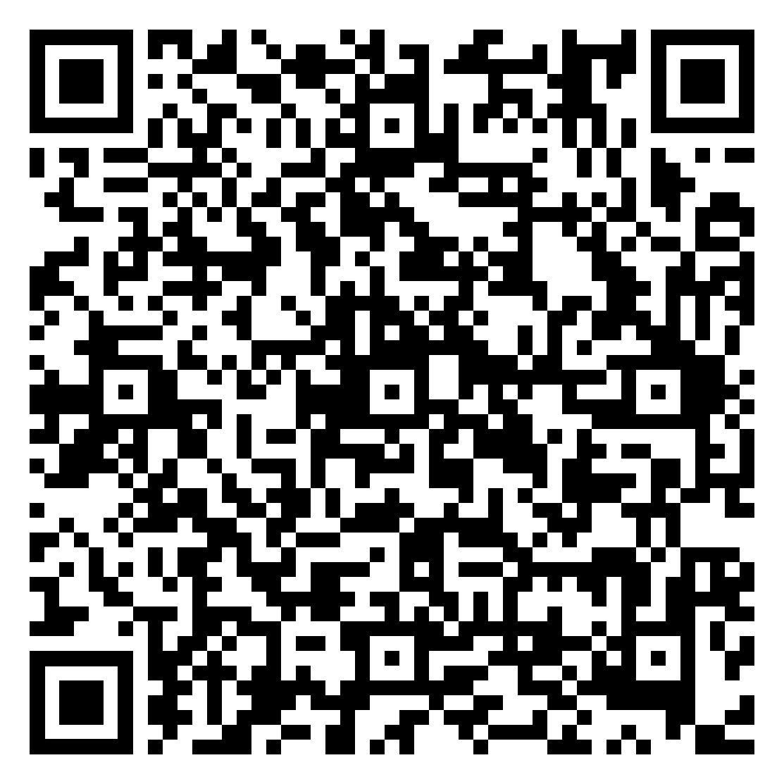
Before: Creating an Agenda
Define the meeting’s purpose and expected outcomes
Compile the list of Agenda Items
Assign the person responsible to lead the discussion on each item
Next to each major topic, include the type of action needed, the type of output expected (decision, vote, action assigned to someone), and time estimates for addressing each topic
The agenda should include:
  Review the prior meeting’s minutes
  Review the action items of the previous meeting
  Informational items
  Discussion items
  Action items

Slide 21
During: Taking Notes
Stay focused: Record important ideas, decisions, and actions.
Write by hand: Take notes on paper and then type them up after the meeting.
Keep it simple: Record the date, time, meeting title, and key information.
Organize afterwards: Group actions, decisions, and information together.
Review and summarize: Highlight important points and write a short summary.

Slide 22
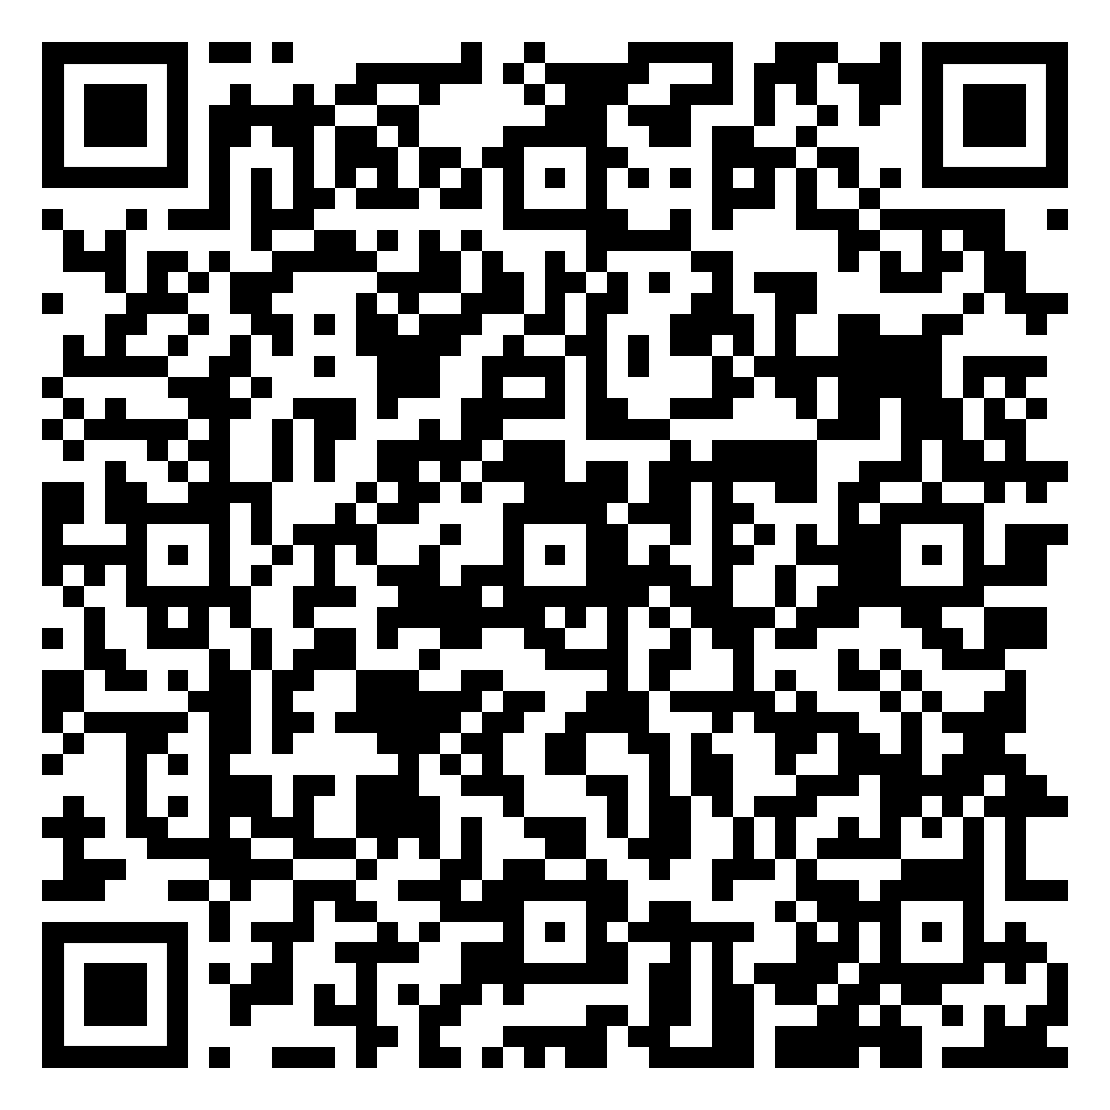
After: Meeting Minutes
Distribute with 24 hours
Need to include details of:
  Names of attendees
  Notations of who was absent
  Acceptance/Corrections to the previous meeting minutes
  Decisions made (motions made, votes, etc.)
  Next steps planned
  Identification and tracking of action items (and responsibilities)
  Date of next meeting
  Copies of supporting documents
Be objective
Use the same tense
Avoid names (except for motions & seconds)
Refer to other documents in an appendix, don’t include them in the minutes

Slide 23

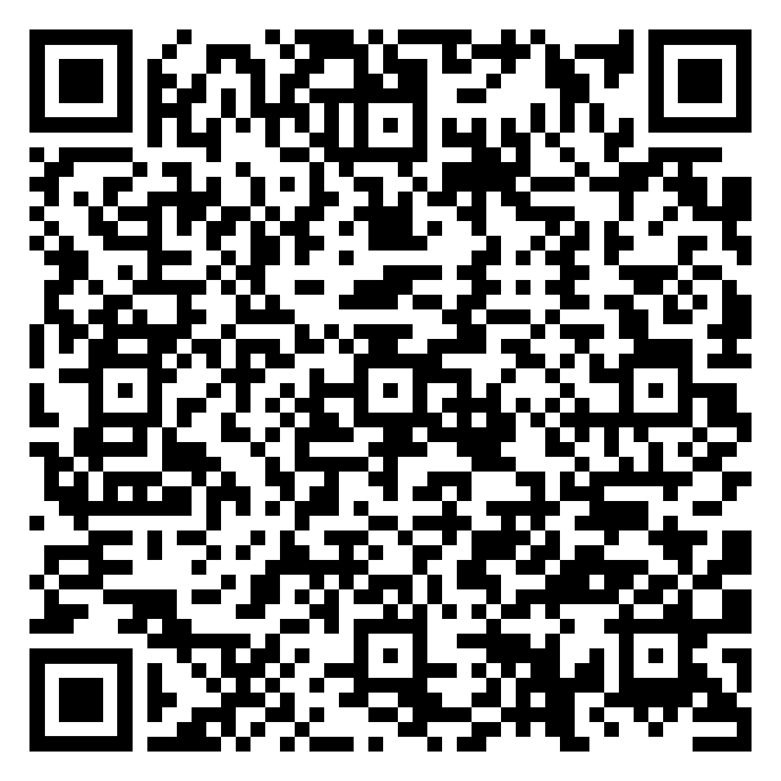
How To Run a Business Meeting

Slide 24
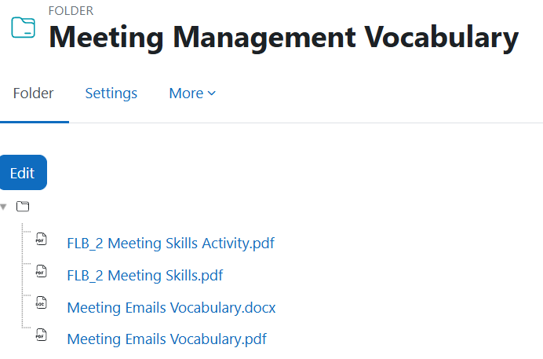
Meeting Management Vocabulary

Slide 25
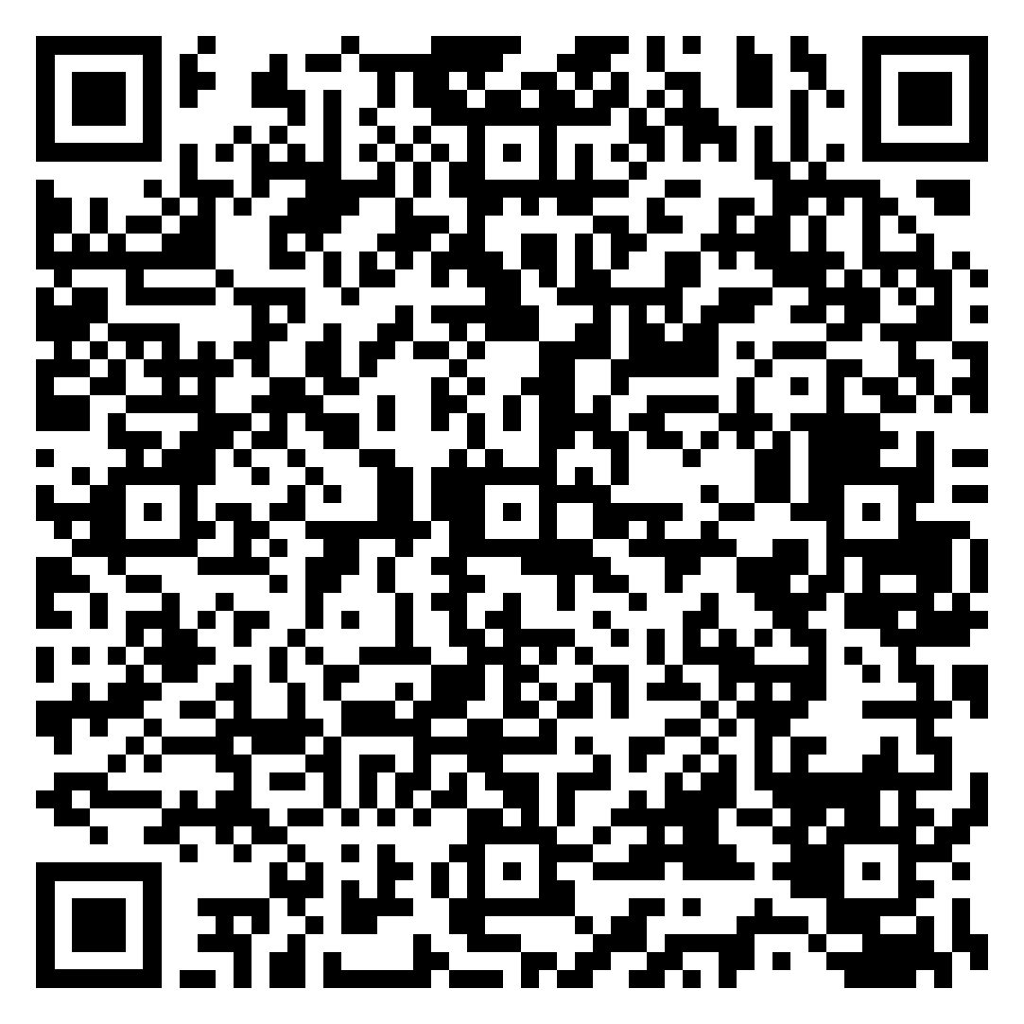

Role Play: Business Information Briefing
SITUATION: IMAGINE:
You are a team of business consultants working for Mahidol University.
University management has identified a problem and asked your consultancy to investigate it.
Audience: University management
Purpose: Find out what students think and experience, identify the most important findings, and report them to management.
Important: Your consultancy investigates the problem. You do not provide solutions or recommendations.

Slide 26
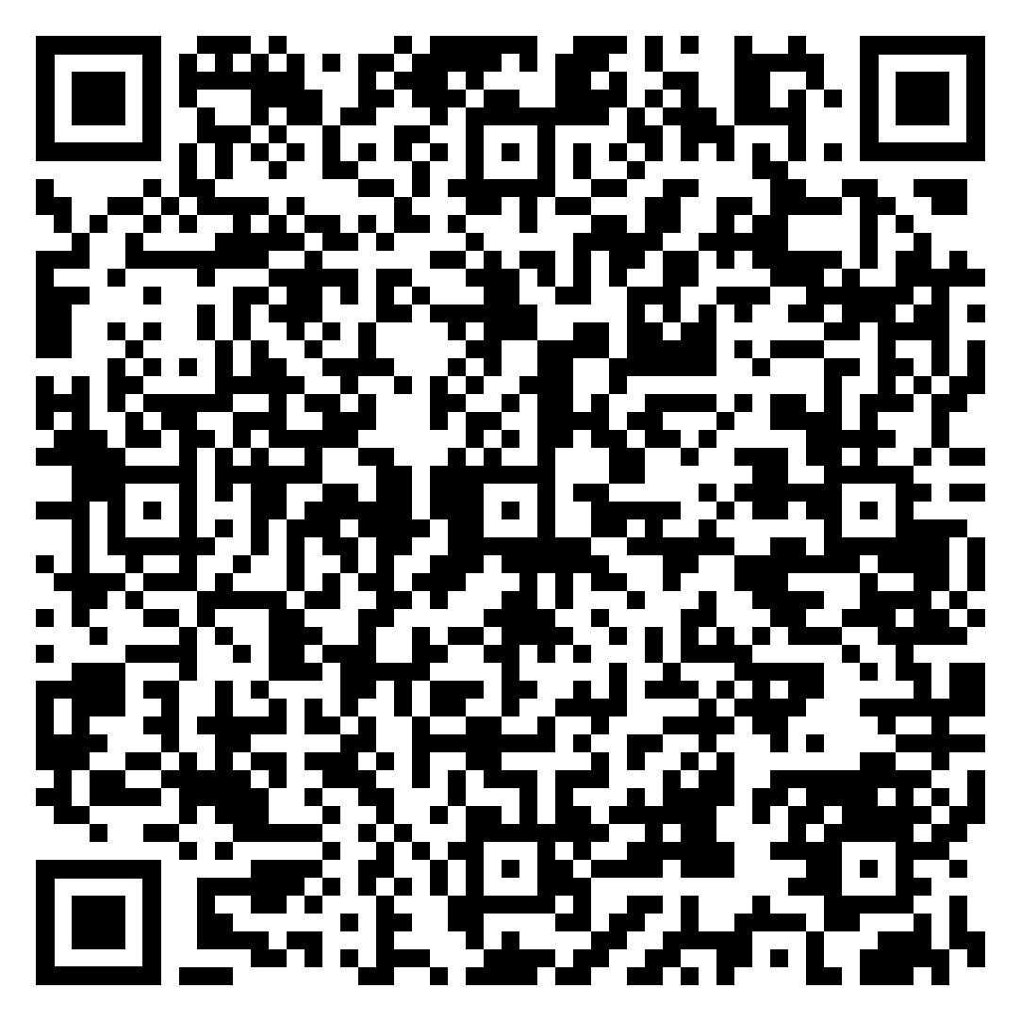
Consultancy Groups:
Today, your consultancy will get ready for the investigation.
1. Form your group of 3–4 people.
2. Choose ONE of the 3 situations.
3. Agree on group-work roles and responsibilities.
4. Set up your communication channel.
5. Share your work/study availability.
6. Decide when you will hold your assessed team meeting.
7. Review the project instructions before the meeting.
8. Start preparing information and possible questionnaire questions for your meeting
Your goal today: Be ready to plan and conduct you online meeting outside of class.

Slide 27
Consultancy Groups:
Choose ONE situation.
You need to collect information on this issue before reporting your findings.
Situation 1: Group Project Problems
  What problems do students experience when working in groups?
  How often do these problems occur?
  What do students think about group projects?
Situation 2: Campus Study Space Problems
  What problems do students experience when looking for study spaces?
  When do these problems occur?
  How do students feel about the current study spaces?
Situation 3: University Technology Problems
  What technology problems do students experience?
  How often do these problems occur?
  How do these problems affect students?

Slide 28
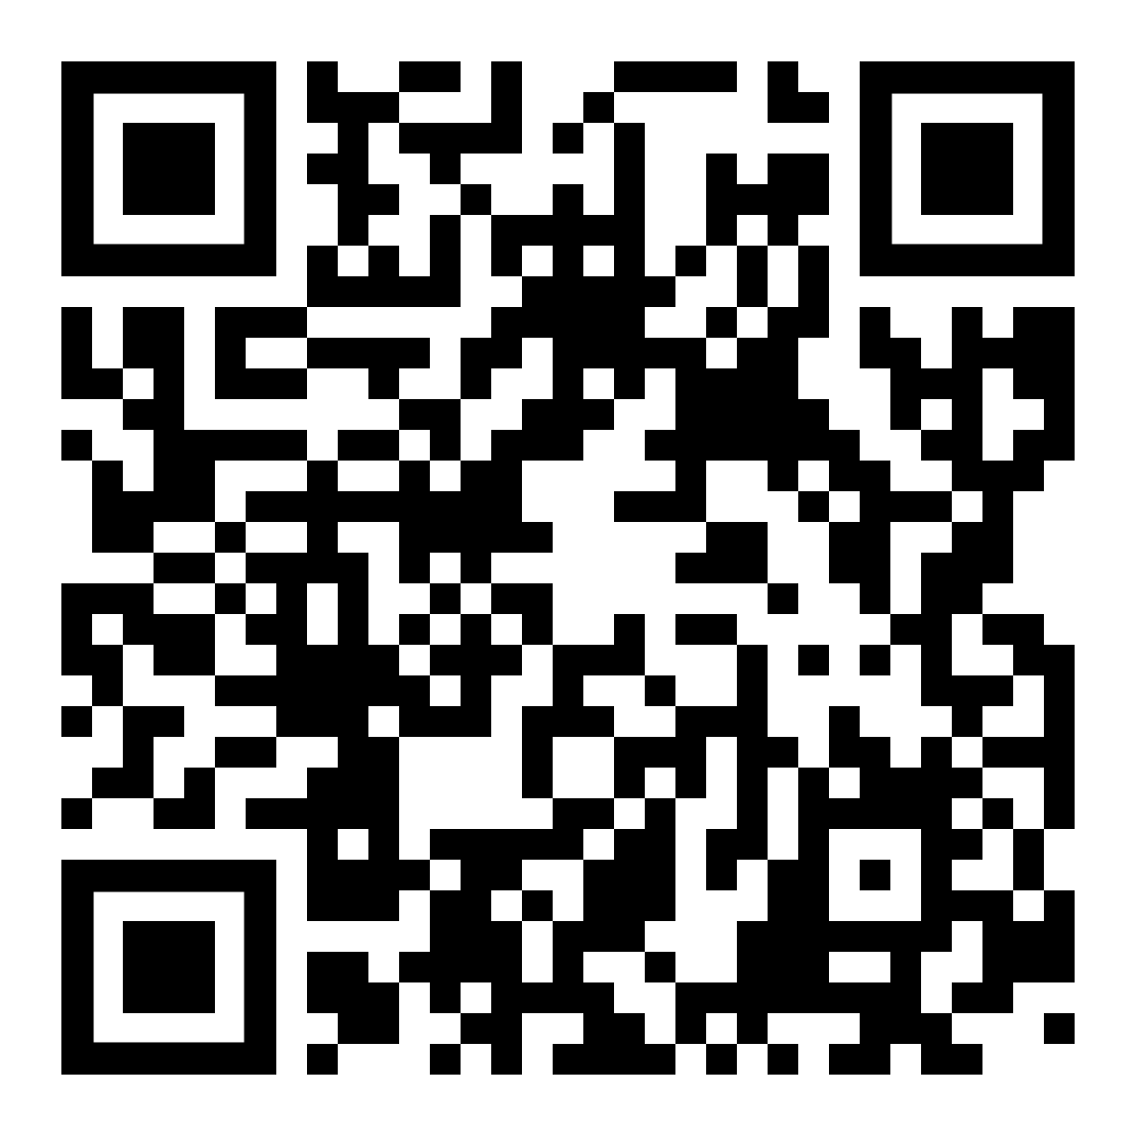
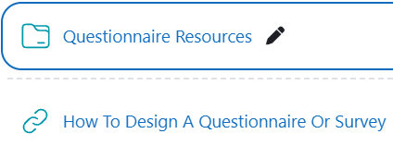
Questionnaire Design
Start with What You Need to Know
Write Clear, Useful Questions
Start with the investigation purpose
Put important questions early
Ask only for information you need and will use
Make sure questions will support your later analysis
Use open questions when you need explanation
Use simple, direct language
Ask one thing at a time
Do not suggest the answer in your questions
Make response options appropriate and non-overlapping

Slide 29
Business Briefing Deliverables for Next Week
Your assessed team meeting takes place outside class and must be recorded.
Next week you should submit the following through the progress update email to the CEO:
Team Meeting Recording
Meeting Minutes
Final Questionnaire
15–20 Questionnaire Responses
Progress Update to the CEO

Slide 30
Lesson Recap: Key Takeaways
Consultation: Consultants provide advice and expertise to help address a business problem
Business Meetings: Meetings help teams share information, make decisions, and coordinate work
Meeting Management: Effective meetings require preparation, clear management, and follow-up
Agendas: A good agenda gives a meeting a clear purpose, structure, and expected outcomes
Meeting Minutes: Good minutes record important discussion, decisions, responsibilities, and next steps
Action Items: Clear action items identify the task that needs to be completed, the responsible person, and the deadline
Professional Teamwork: Effective teams communicate clearly, participate actively, and follow through on responsibilities
Good consultants need more than good ideas. They need to communicate clearly, manage meetings effectively, and work professionally as a team.

Slide 31
Congratulations on surviving another class
THANK YOU for your participation today
Have a great week everyone!
See you next week
Until then, Take Care & Stay Safe
Finally….

